Slide 1
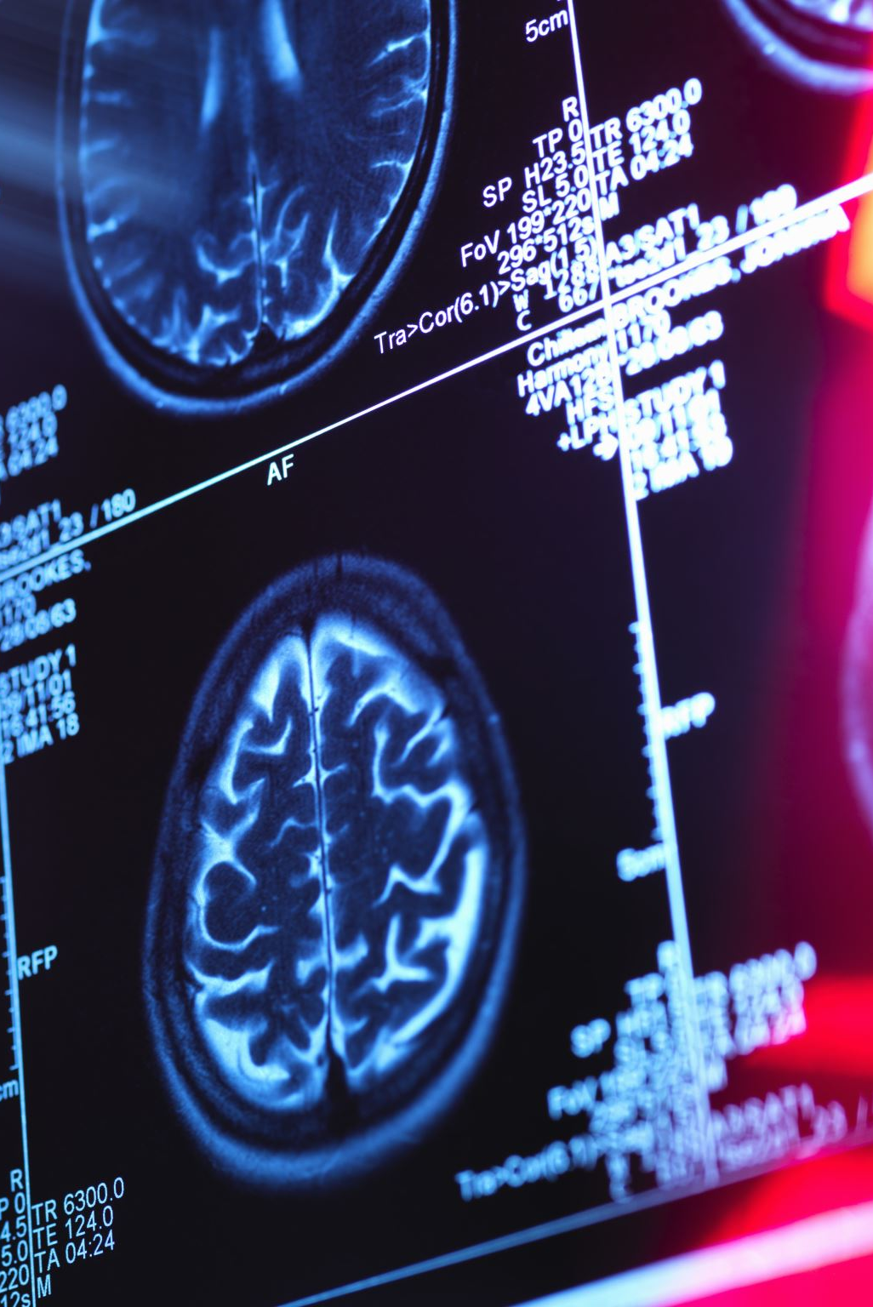
Distribution Shift in Medical Imaging
Using Autoencoder Reconstruction Error to Predict Model Performance on New Data
Sharad George & Moataz Mansour
CAS AML Project
Notes:
Good morning everyone. Today I’ll present our CAS AML project on distribution shift in medical imaging.
The key idea: we train models on one big chest X‑ray dataset (NIH) and ask how well they generalize to
other datasets, and whether we can predict performance drop using an unsupervised signal from an autoencoder.

Slide 2
Why Distribution Shift Matters
Models are usually trained on one ‘clean’ dataset
In the real world, data comes from new hospitals and populations
If the distribution changes, performance can silently degrade
In medical imaging this can directly affect patient care
Notes:
Explain the general problem: a model trained on one dataset may see very different data in deployment.
In radiology this can mean different scanners, protocols, demographics. If we don’t monitor this shift,
the model may look fine in offline tests but fail in production.

Slide 3
Research Question & Approach
Can we detect distribution shift in chest X‑ray images without labels?
Can autoencoder reconstruction error act as an early‑warning signal?
How does this relate to actual classifier performance on new datasets?
Notes:
State the core research question. Emphasize ‘without labels’ as the key constraint.
We want a practical tool that works even when a new hospital has not yet annotated many images.
We will compare unsupervised signals from an autoencoder with the performance of a DenseNet classifier.

Slide 4
Datasets Used
NIH – US East Coast NIH center, mostly adult dataset, our training domain
Pediatric – Chinese Hospital, fully children dataset
CheXpert – US West Coast Stanford Hospital, mostly adult dataset
Deliberately different in institution, demographics and pathology mix
Notes:
Briefly describe each dataset and why we chose it. NIH is our reference domain.
Pediatric introduces both demographic and institutional shift. CheXpert is another large
US dataset but from a different hospital and with a very different class balance.

Slide 5
Label Distributions
B
NIH: relatively balanced normals vs abnormals (≈ 54% / 46%)
Pediatric: many more pneumonia cases (≈ 27% normal / 73% abnormal)
CheXpert: heavily skewed toward abnormal (≈ 4% normal / 96% abnormal)
These differences already hint at shift and evaluation challenges; so Branch _a (normal + abnormal) Branch _b (normal)
Notes:
Explain that beyond images themselves, the label prevalence is very different.
This will later motivate why plain accuracy can be misleading and why we use balanced accuracy.

Slide 6
Phase 1 – Baseline Distribution Shift
Compare pixel intensity distributions across datasets
1
Compute Jensen–Shannon (JS) divergence between datasets
2
Even simple statistics show NIH, Pediatric, CheXpert are not identical
3
Notes:
Describe that Phase 1 is a very low‑level look: no learning yet.
We compute JS divergence between pixel histograms to quantify difference between datasets.
This establishes that a shift exists before we train any model.

Slide 7
Phase 1 – Key Findings
JS divergence indicates noticeable shift between all dataset pairs
Normals‑only comparison still shows clear gaps
Not all differences are due to pathology – institution/technical factors matter
Notes:
Highlight that even when restricting to normal images, NIH vs Pediatric vs CheXpert still differ.
This suggests that scanners, protocols, and processing pipelines are important components of shift.

Slide 8
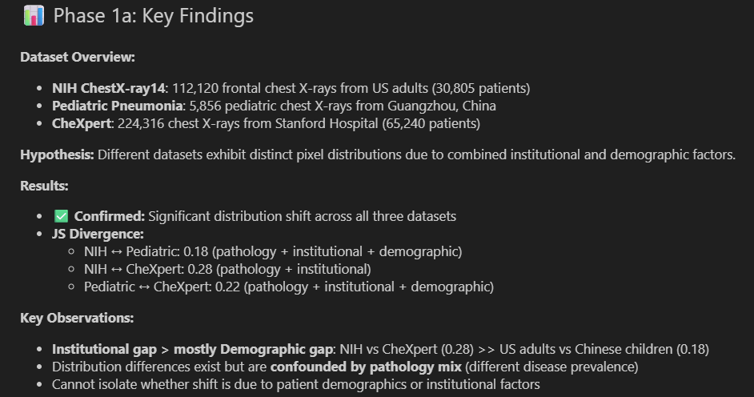
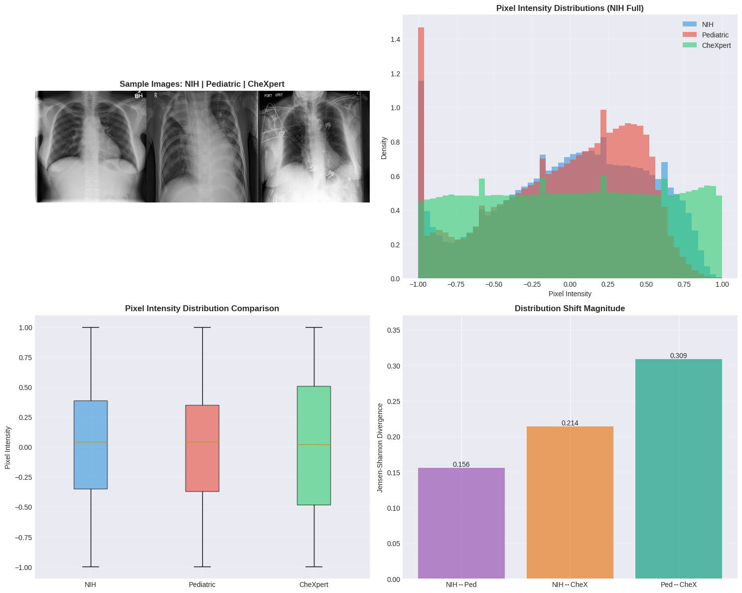
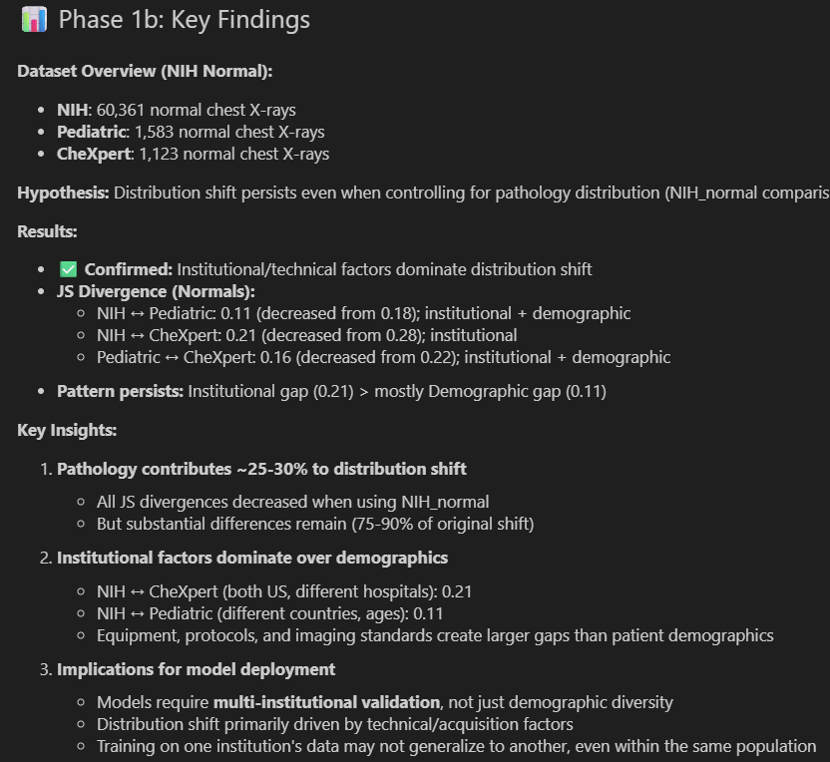
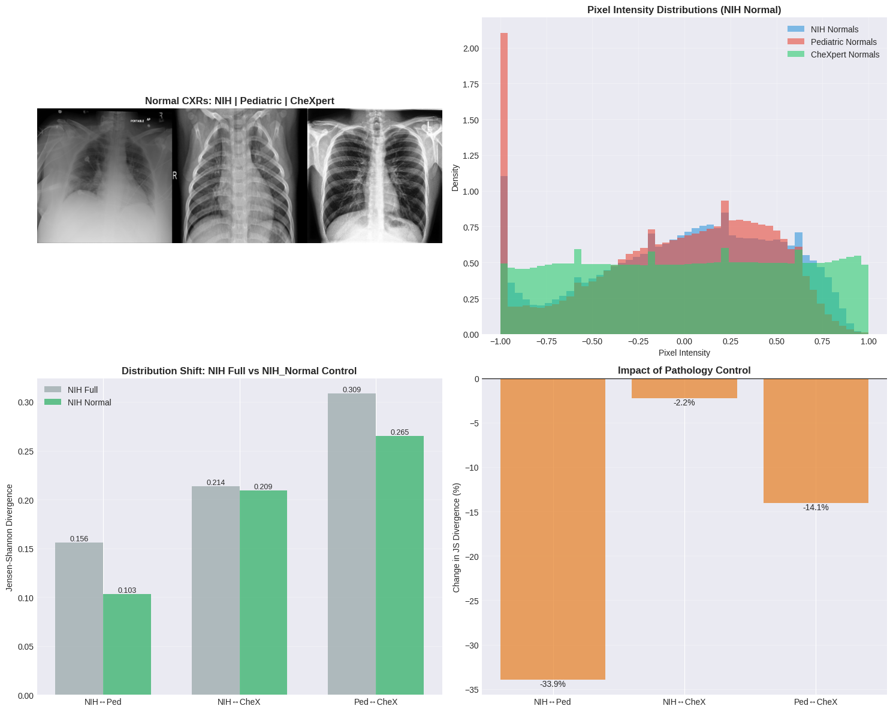
Phase 2 – Convolutional Autoencoder
Notes:
Explain the CAE architecture only at a high level: conv layers down, conv‑transpose up.
NIH_Full AE is trained on all NIH images; NIH_Normal AE is trained only on NIH normals.
Both aim to reconstruct the input; the loss is reconstruction error (e.g. MSE).

Slide 9
Phase 2 – Convolutional Autoencoder
Convolutional encoder–decoder network with ~27M parameters
Input: 1×224×224 chest X‑ray (resized & normalized)
Latent space: 256‑dimensional vector (compressed representation)
Two variants: NIH_Full AE and NIH_Normal AE
Notes:
Explain the CAE architecture only at a high level: conv layers down, conv‑transpose up.
NIH_Full AE is trained on all NIH images; NIH_Normal AE is trained only on NIH normals.
Both aim to reconstruct the input; the loss is reconstruction error (e.g. MSE).

Slide 10
Phase 2 – Training Results
Autoencoders converge with low reconstruction error on NIH images
NIH_Normal AE: abnormals show ~+6.6% higher error than normals
This +6.6% is our baseline ‘pathology effect’ within NIH
Notes:
Emphasize that the AE learns the NIH distribution well: reconstruction error is low and stable.
When NIH_Normal AE sees abnormal NIH images, the error increases moderately (~6.6%).
This number is important later when we compare it with cross‑dataset shifts.

Slide 11
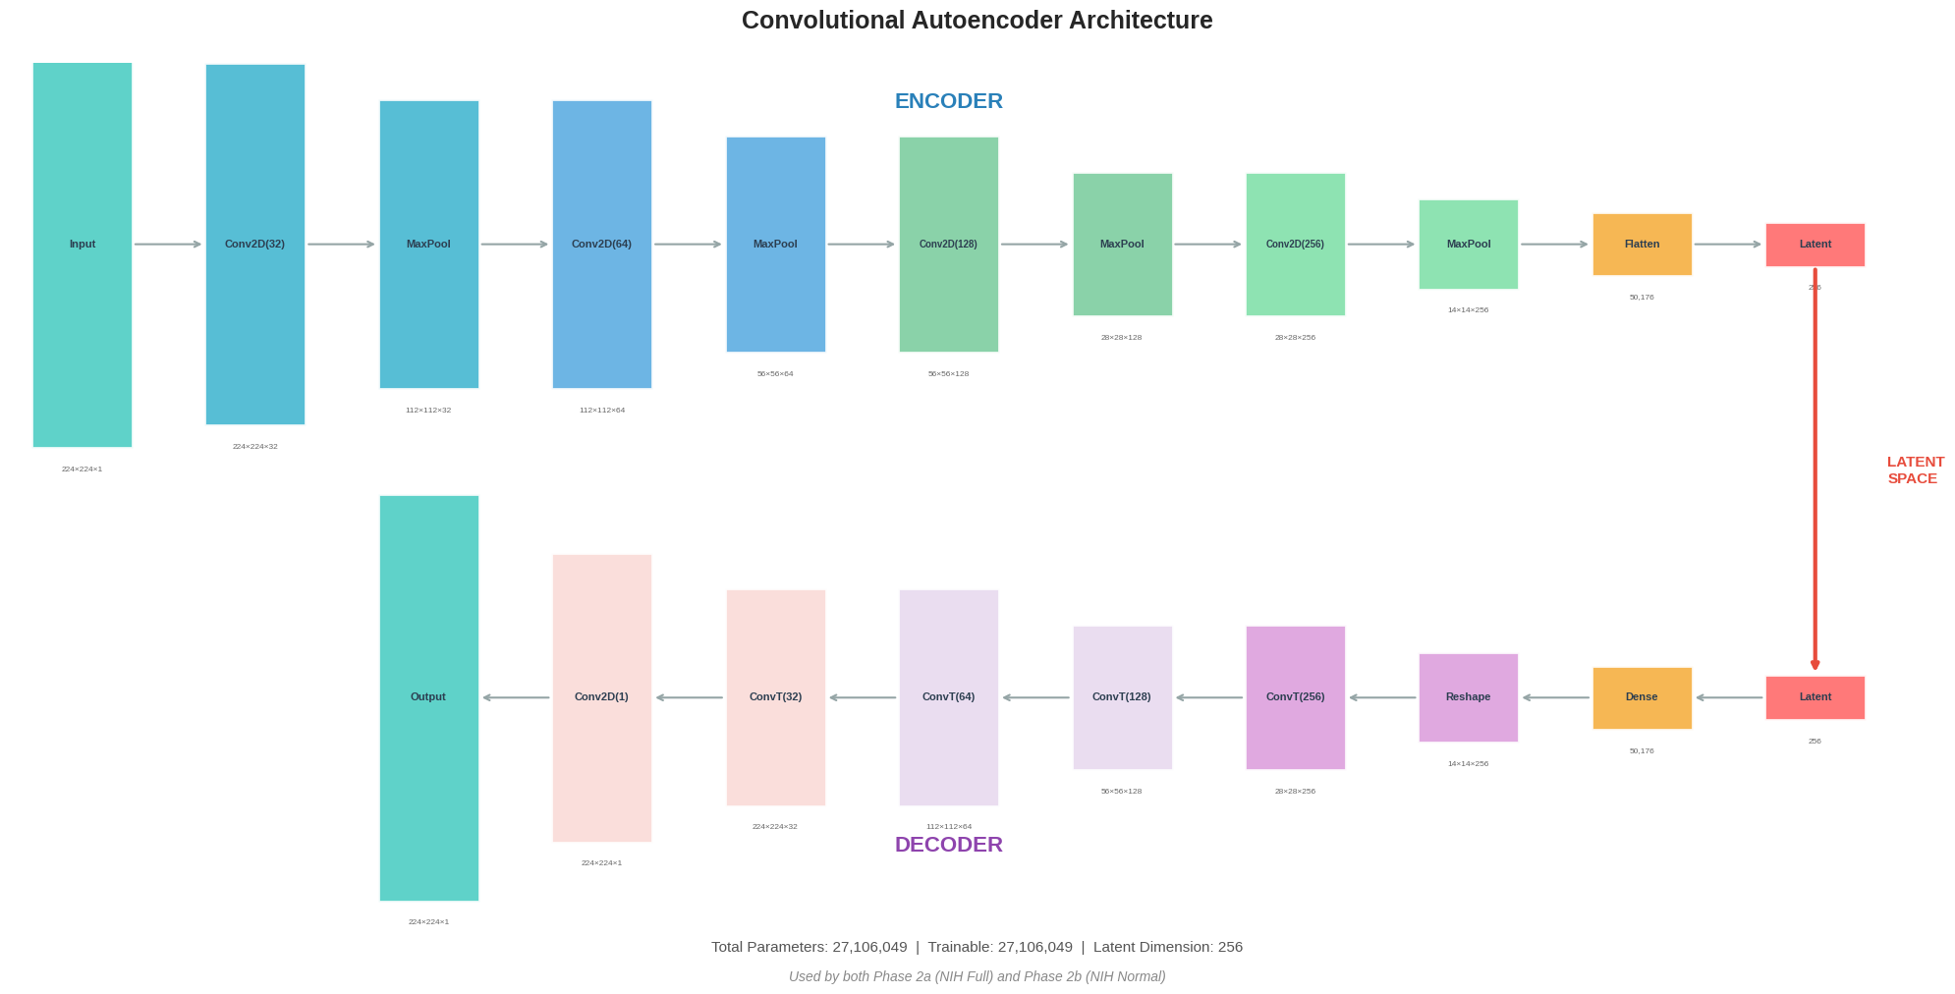
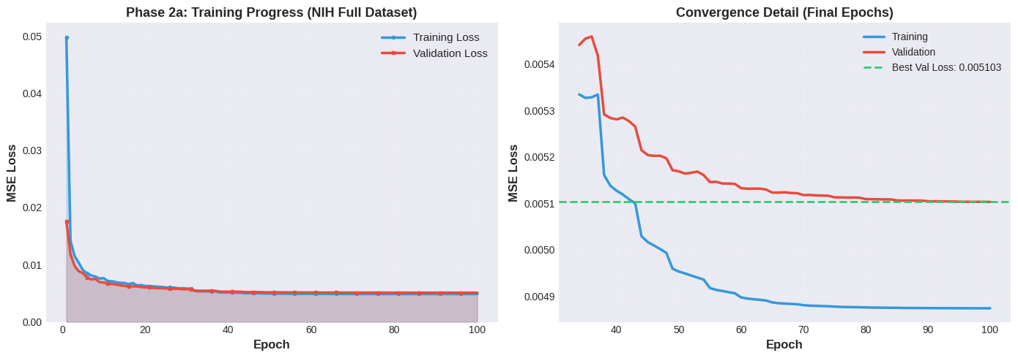
Phase 2 – Training Results
Notes:
Emphasize that the AE learns the NIH distribution well: reconstruction error is low and stable.
When NIH_Normal AE sees abnormal NIH images, the error increases moderately (~6.6%).
This number is important later when we compare it with cross‑dataset shifts.

Slide 12
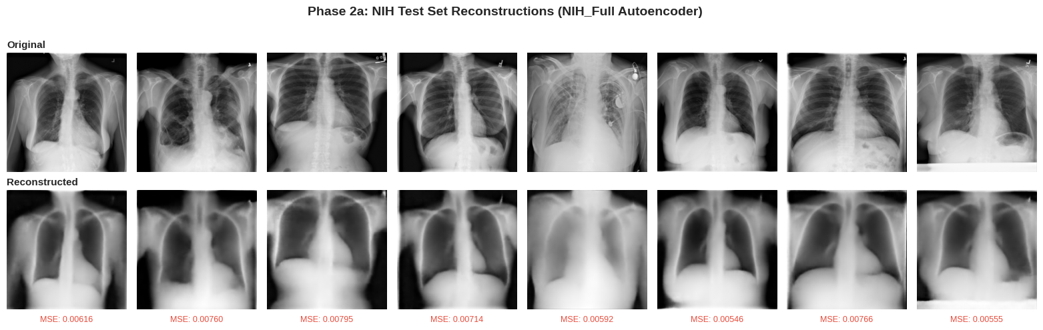
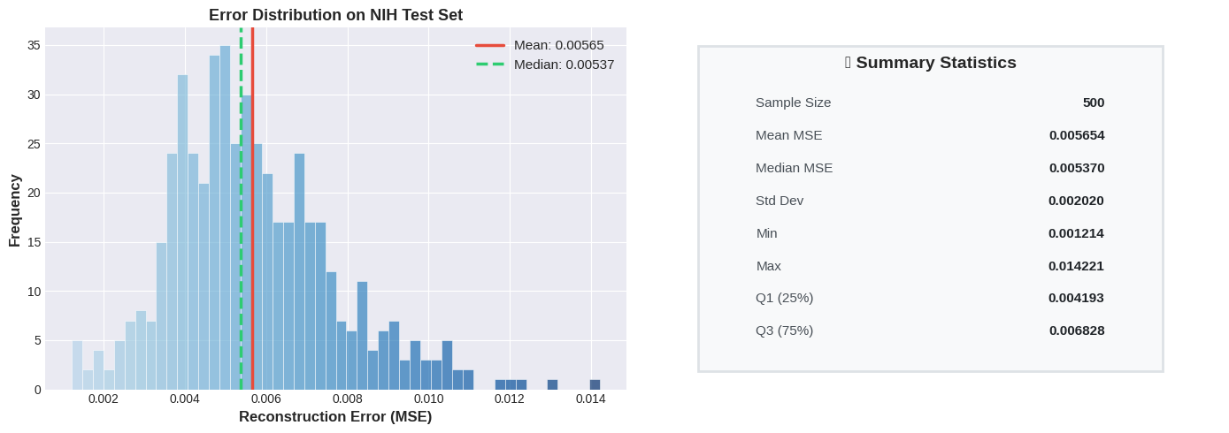
Phase 2 – Training Results
Notes:
Emphasize that the AE learns the NIH distribution well: reconstruction error is low and stable.
When NIH_Normal AE sees abnormal NIH images, the error increases moderately (~6.6%).
This number is important later when we compare it with cross‑dataset shifts.

Slide 13
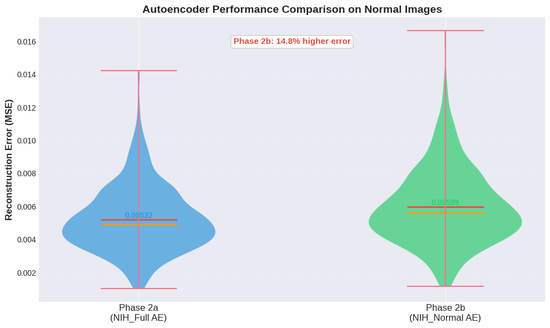
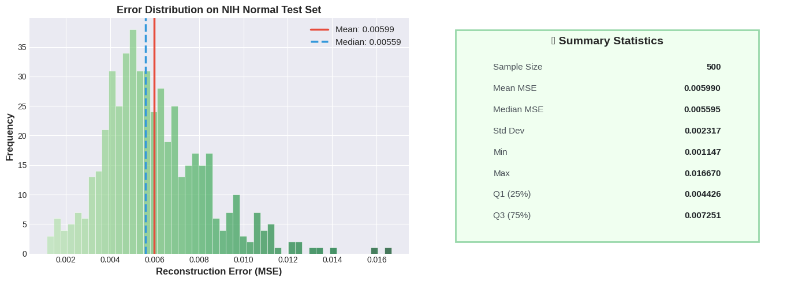
Phase 2 – Training Results
Notes:
Emphasize that the AE learns the NIH distribution well: reconstruction error is low and stable.
When NIH_Normal AE sees abnormal NIH images, the error increases moderately (~6.6%).
This number is important later when we compare it with cross‑dataset shifts.

Slide 14
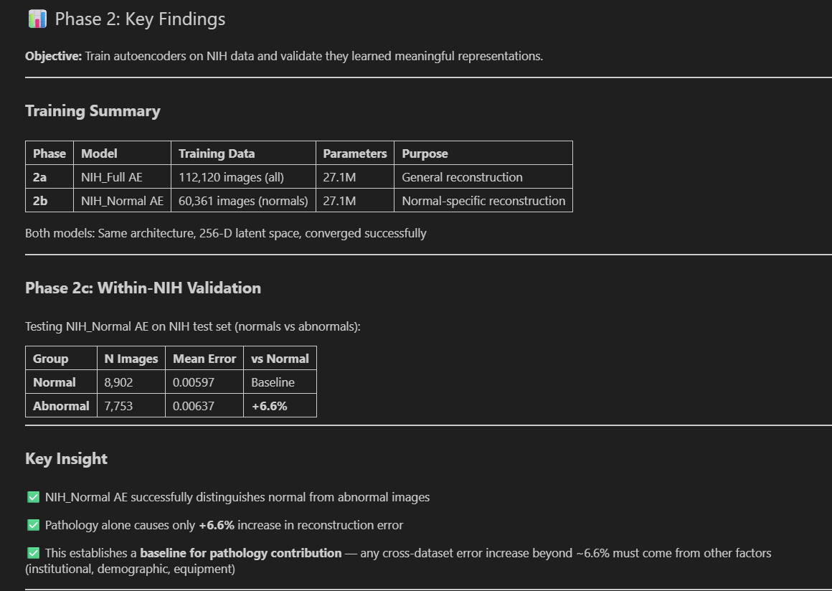
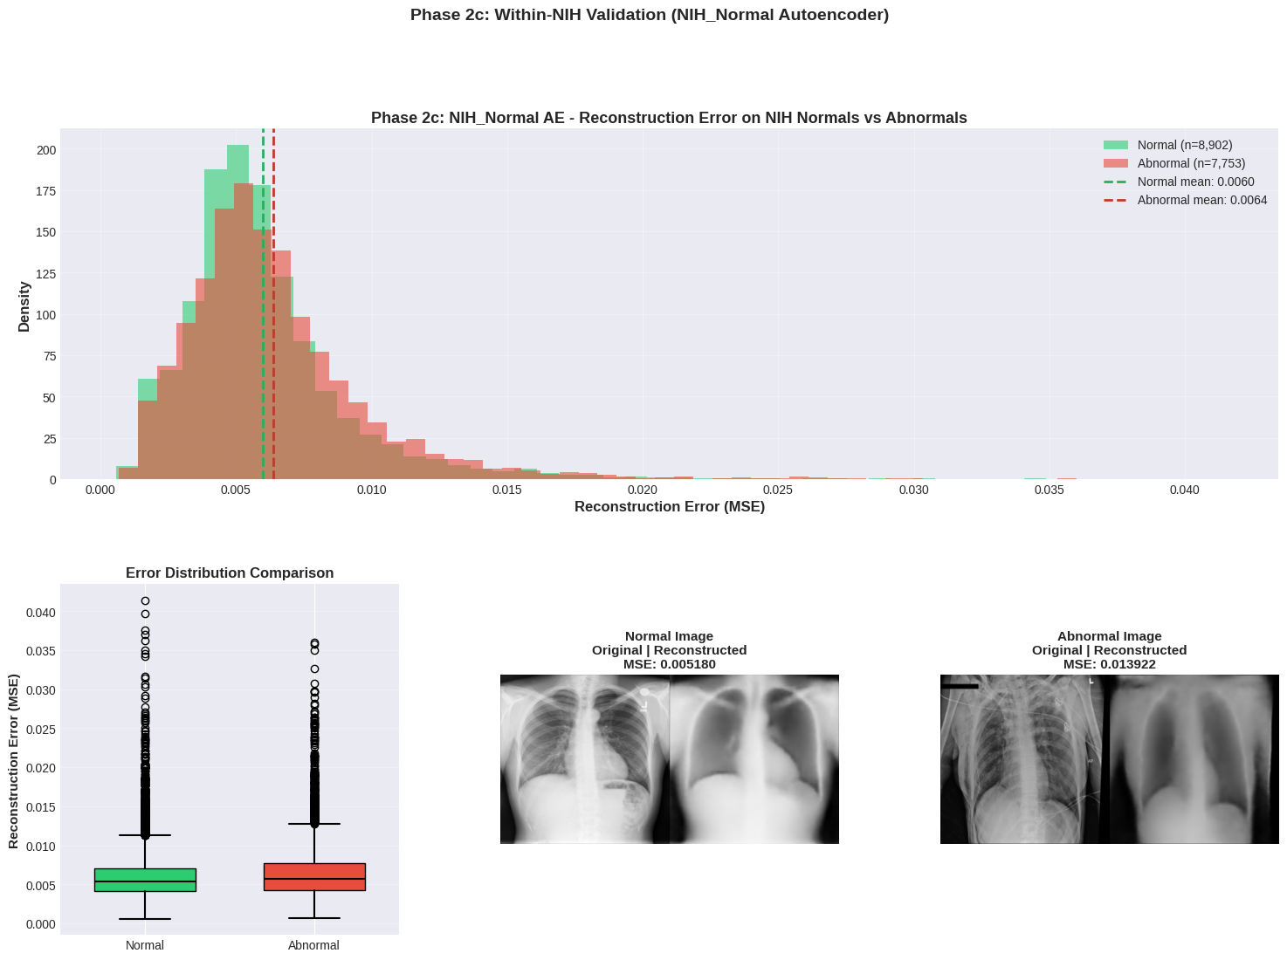
Phase 2 –Key Findings
Notes:
Emphasize that the AE learns the NIH distribution well: reconstruction error is low and stable.
When NIH_Normal AE sees abnormal NIH images, the error increases moderately (~6.6%).
This number is important later when we compare it with cross‑dataset shifts.

Slide 15
Phase 3 – Reconstruction Error Across Datasets
Keep AE weights fixed and change only the input dataset
1
Compute mean reconstruction error for NIH, Pediatric, CheXpert
2
Use both NIH_Full AE and NIH_Normal AE
3
Notes:
Explain the protocol: the AE is trained only on NIH. Then we feed in Pediatric and CheXpert images
and measure how much the reconstruction error increases compared to NIH baseline.

Slide 16
Phase 3 – Quantitative Results
NIH_Full AE: Pediatric ≈ +114% error vs NIH baseline
NIH_Full AE: CheXpert ≈ +218% error vs NIH baseline
NIH_Normal AE shows an even stronger separation
All differences highly significant (non‑parametric tests, p < 0.001)
Notes:
Walk the audience through the relative error increases. Contrast them with the modest +6.6% pathology
effect within NIH. This shows that cross‑institution + demographic shift is much larger than pathology alone.

Slide 17
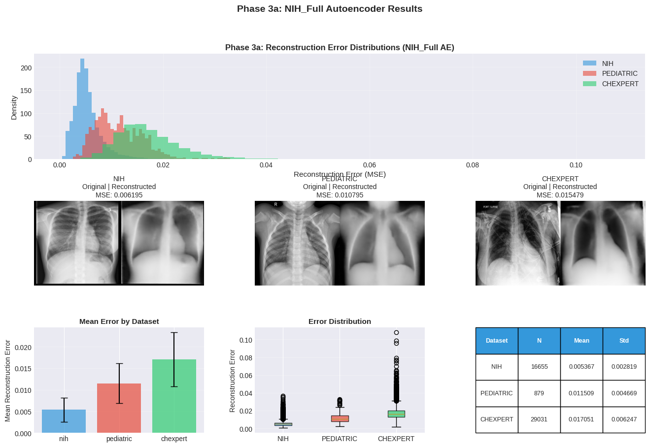
Phase 3 – Quantitative Results
Notes:
Walk the audience through the relative error increases. Contrast them with the modest +6.6% pathology
effect within NIH. This shows that cross‑institution + demographic shift is much larger than pathology alone.

Slide 18
Phase 3 – Quantitative Results
Notes:
Walk the audience through the relative error increases. Contrast them with the modest +6.6% pathology
effect within NIH. This shows that cross‑institution + demographic shift is much larger than pathology alone.

Slide 19
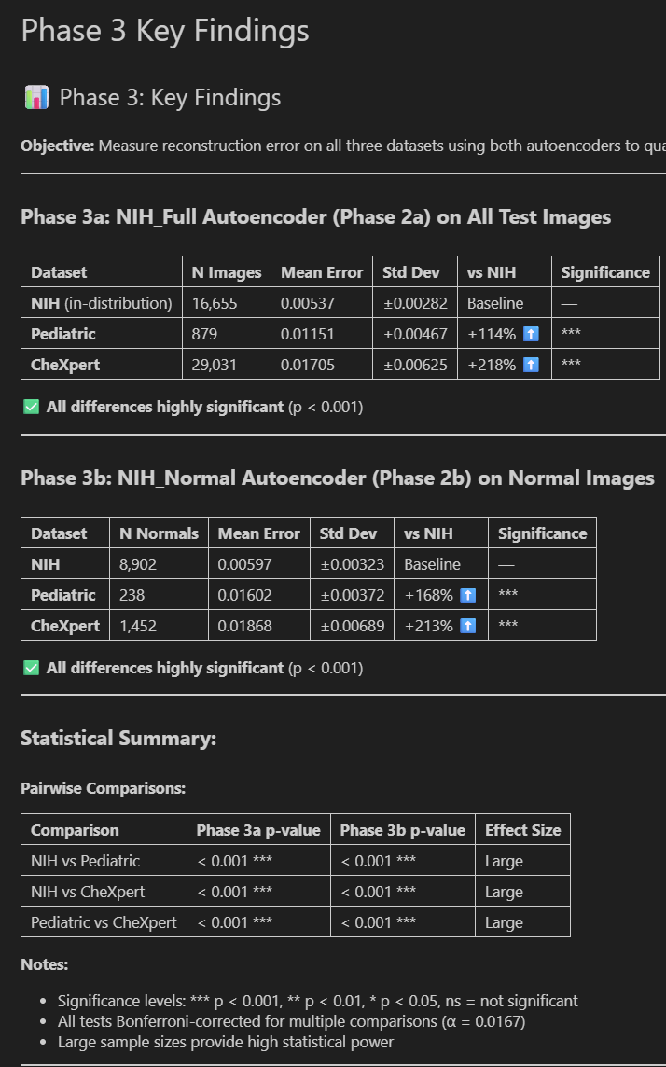
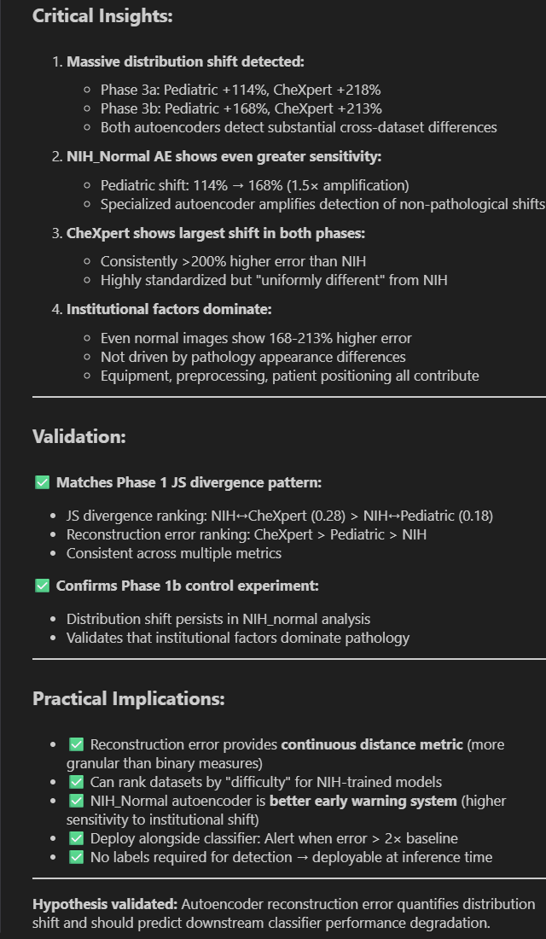
Notes:
Walk the audience through the relative error increases. Contrast them with the modest +6.6% pathology
effect within NIH. This shows that cross‑institution + demographic shift is much larger than pathology alone.

Slide 20
Phase 3 – Interpretation
Reconstruction error behaves like a ‘distance’ from the NIH training distribution
Pediatric and CheXpert are much farther away than NIH abnormals
Suggests institutional/technical and demographic factors dominate the shift
Notes:
Summarize the story: the AE sees Pediatric and especially CheXpert as very different from NIH.
This supports the idea that reconstruction error can act as an unsupervised domain‑shift indicator.

Slide 21
Phase 3c – Latent Space Visualization (t‑SNE)
Apply t‑SNE to 256‑dimensional latent vectors from NIH_Normal AE
Each point = one image; color = dataset (NIH / Pediatric / CheXpert)
Datasets form distinct clusters in 2‑D space
Notes:
Explain t‑SNE briefly: a technique to embed high‑dimensional data into 2‑D while preserving local structure.
The clear separation of colors shows that the AE’s latent space distinguishes between datasets.

Slide 22
t‑SNE and Classifier Performance
NIH points cluster together – the training domain
Pediatric and CheXpert clusters are shifted away from NIH
Classifier trained only on NIH is now operating in ‘unfamiliar’ regions
This explains why performance degrades on those datasets
Notes:
Connect the visualization to intuition: distance in latent space corresponds to how unusual images are.
When DenseNet sees data from clusters far from NIH, it is effectively extrapolating, which hurts accuracy.

Slide 23
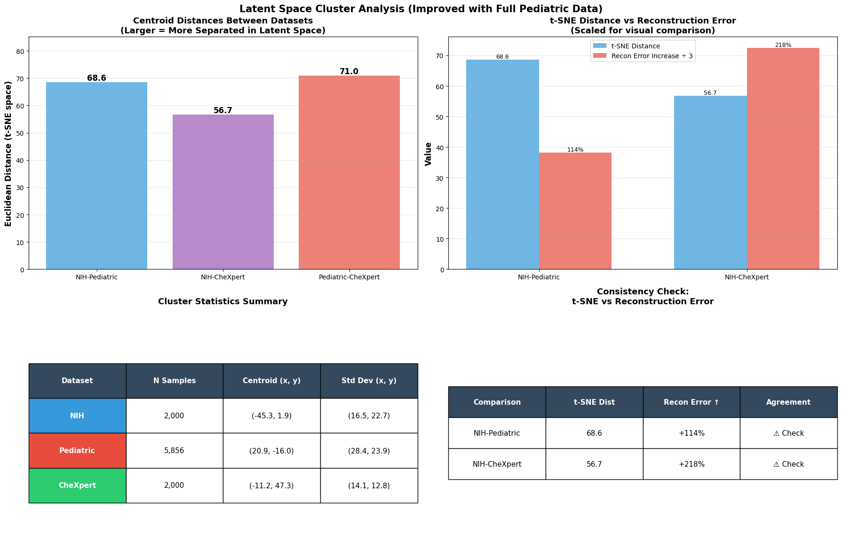
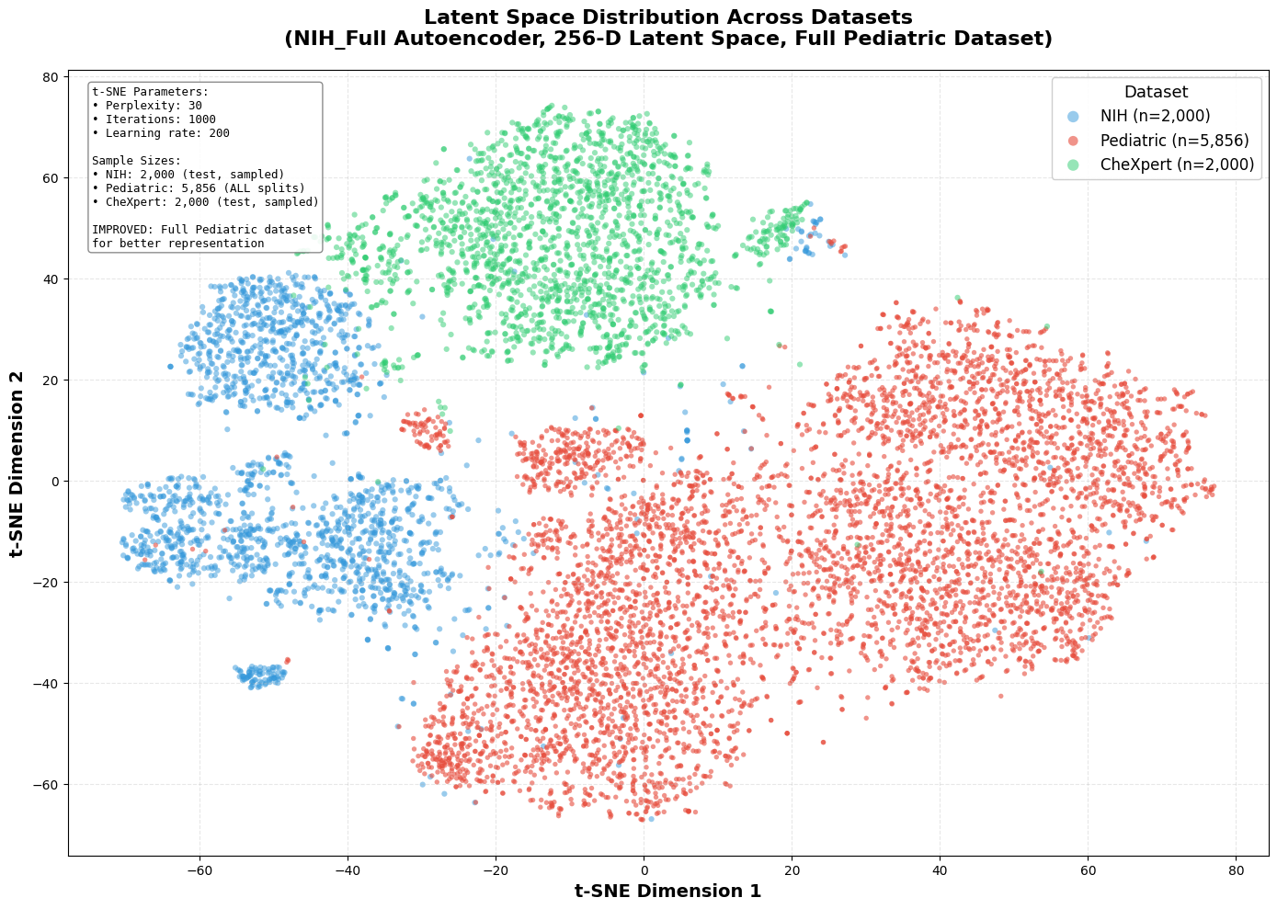
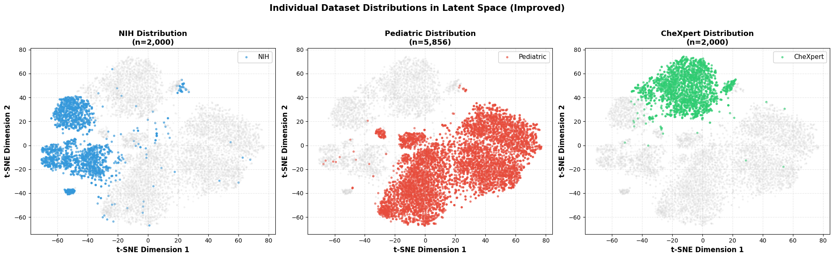
t‑SNE and Classifier Performance
Notes:
Key Findings: • Total samples analyzed: 9,856 • Sample sizes: - NIH: 2,000 - Pediatric: 5,856 (FULL dataset - improved!) - CheXpert: 2,000 • Centroid distances: - NIH-Pediatric: 68.59 - NIH-CheXpert: 56.71 - Pediatric-CheXpert: 70.97 • Consistency with reconstruction errors: ⚠️ STILL INCONSISTENT: Need to investigate further
PHASE 3c: t-SNE LATENT SPACE VISUALIZATION ⚠️ Using FULL Pediatric dataset (train+val+test) to address sample size imbalance and improve centroid stability 📁 Directories: Models: /content/drive/MyDrive/Univ_Bern/CAS_AML/Module_3/Project/chest_xray_distribution_shift/models Results: /content/drive/MyDrive/Univ_Bern/CAS_AML/Module_3/Project/chest_xray_distribution_shift/results/phase3c_all ⚙️ Configuration: NIH samples: 2,000 Pediatric: ALL available (train+val+test) CheXpert samples: 2,000 STEP 1: LOADING ENCODER MODEL ✅ Encoder loaded: nih_full_encoder_final.keras Latent dimension: 256 STEP 2: LOADING SAMPLE IMAGES 📥 Loading samples from each dataset... NIH (test set, sampled): ✅ Total: 2,000 samples Pediatric (ALL splits - train+val+test): train: 4,099 images val: 878 images test: 879 images
...
Reducing from 256D → 2D ⏱️ Expected time: 5-15 minutes (depends on sample size) [t-SNE] Computing 91 nearest neighbors... [t-SNE] Indexed 9856 samples in 0.002s...

Slide 24
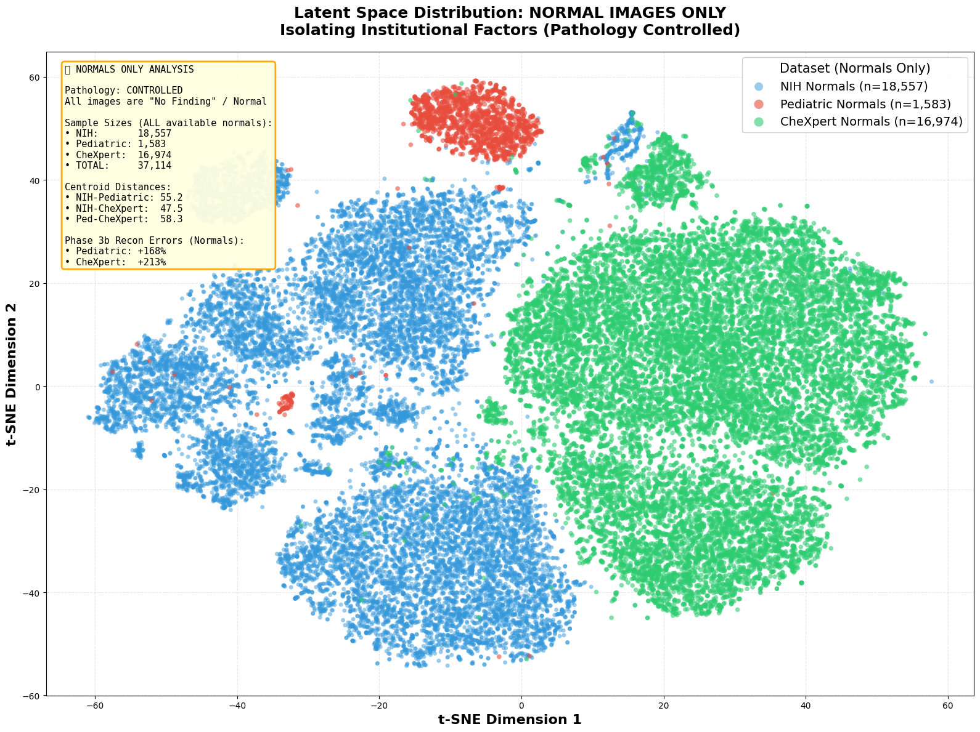
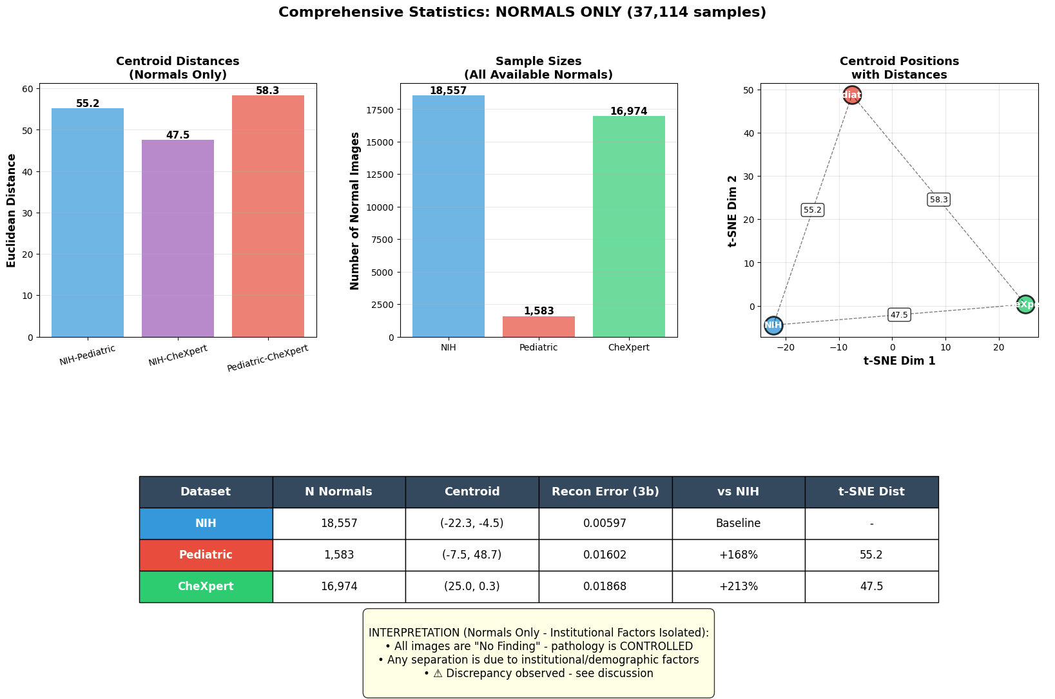
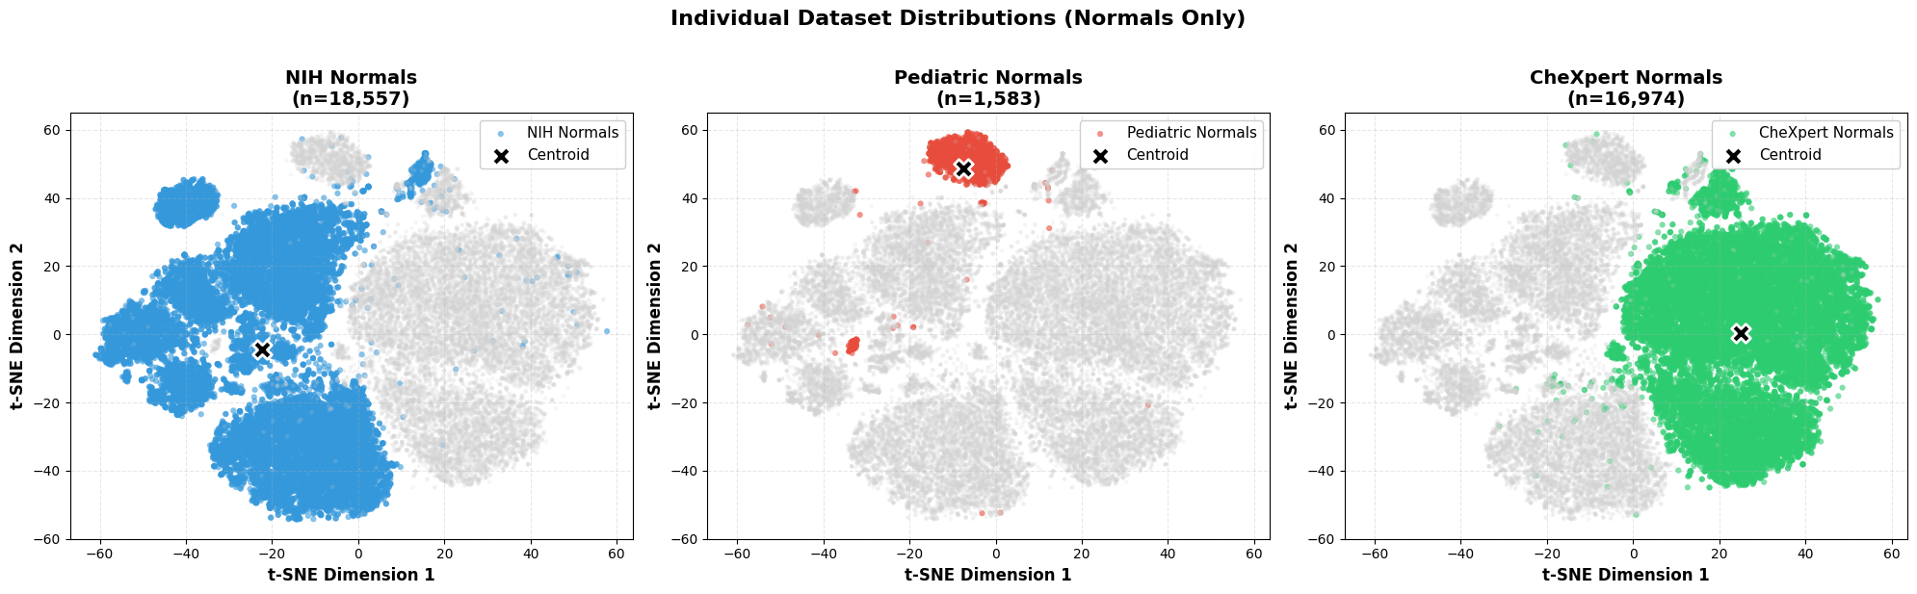
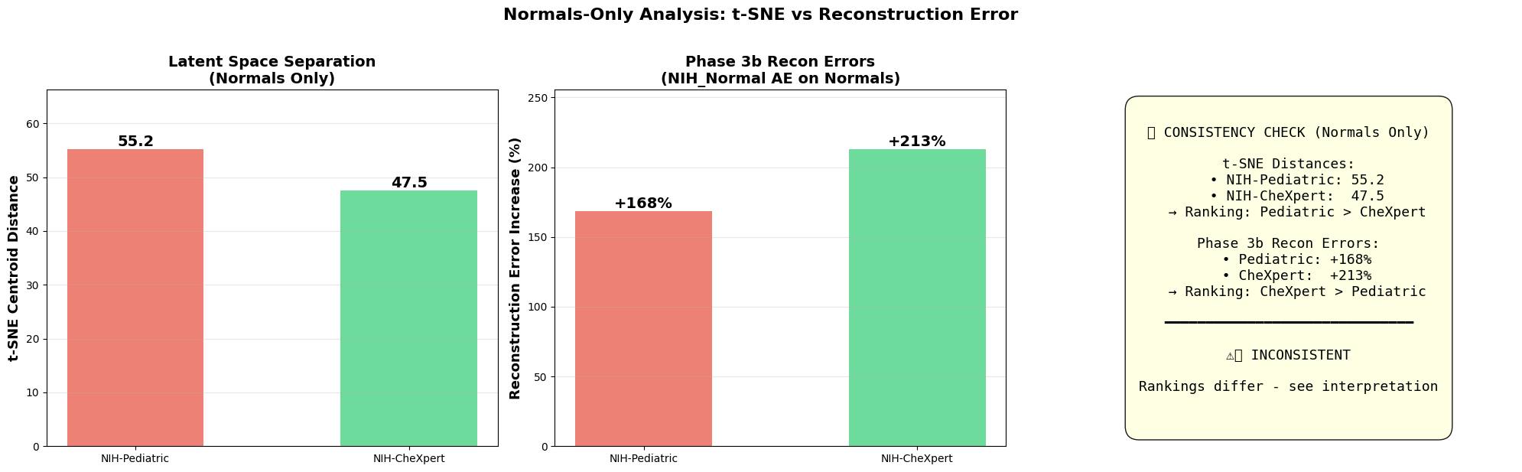
t‑SNE and Classifier Performance
Notes:
FINAL SUMMARY: Analysis type: NORMALS ONLY (pathology controlled) Total samples: 37,114 • NIH: 18,557 normals • Pediatric: 1,583 normals • CheXpert: 16,974 normals Centroid distances (t-SNE): • NIH-Pediatric: 55.19 • NIH-CheXpert: 47.52 • Ped-CheXpert: 58.30 Phase 3b Recon Errors (for comparison): • Pediatric: +168% vs NIH • CheXpert: +213% vs NIH 🎯 CONSISTENCY CHECK: ⚠️ DISCREPANCY DETECTED • t-SNE ranking: Pediatric > CheXpert • Recon error ranking: CheXpert > Pediatric

Slide 25
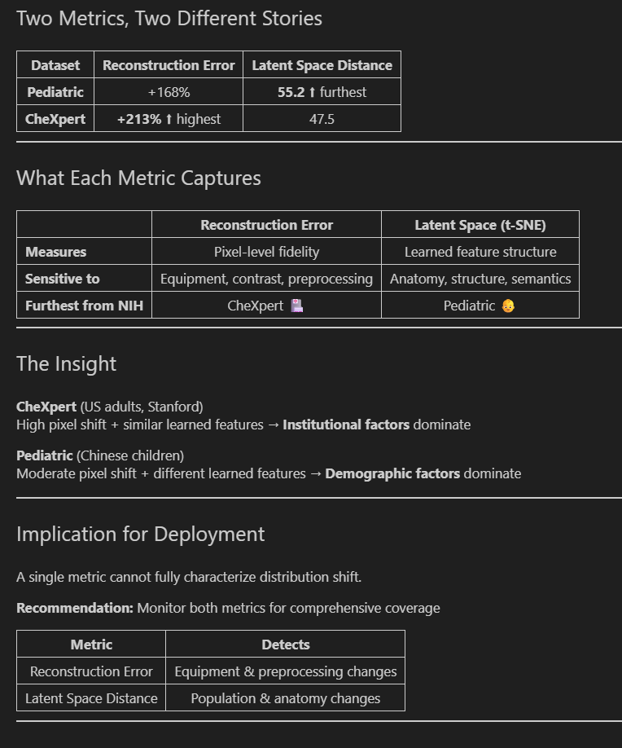
t‑SNE and Classifier Performance
Notes:
Connect the visualization to intuition: distance in latent space corresponds to how unusual images are.
When DenseNet sees data from clusters far from NIH, it is effectively extrapolating, which hurts accuracy.

Slide 26
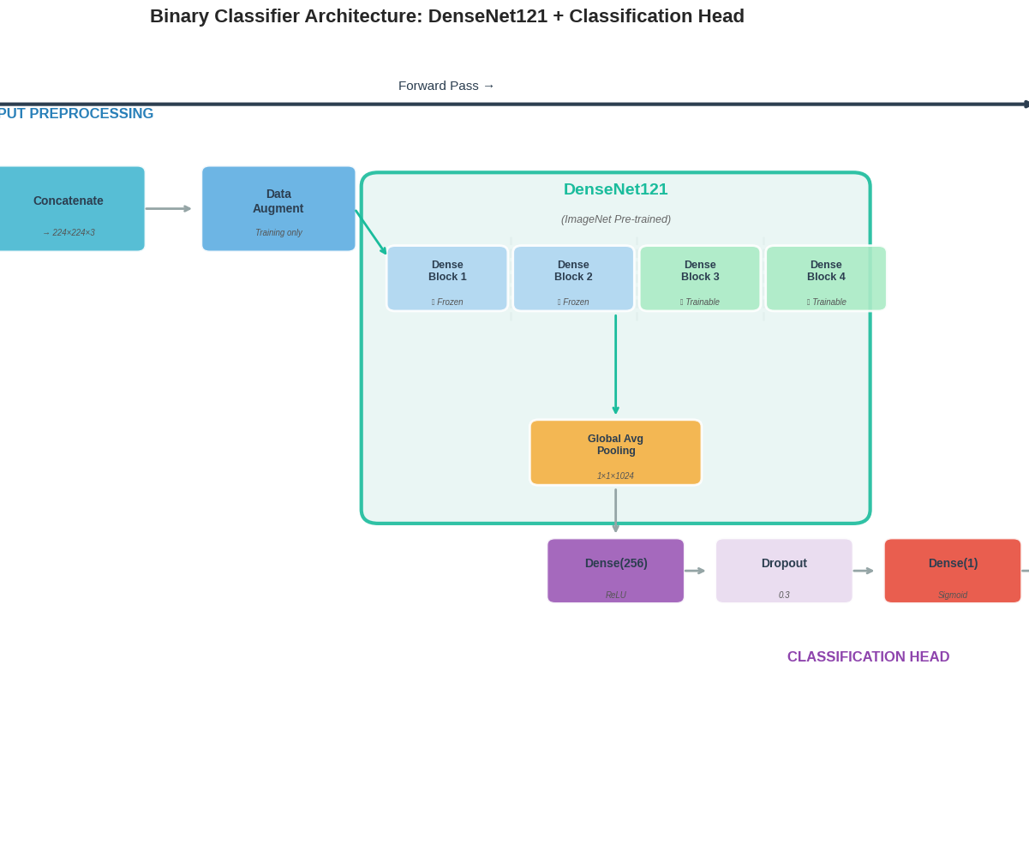
Phase 4 – DenseNet‑121 Classifier
Pre‑trained ImageNet DenseNet‑121 as feature extractor
Early dense blocks frozen; later blocks and head fine‑tuned on NIH
Binary output: abnormal vs normal
Important: classifier uses processed images pixels, not AE latent features
Notes:
Clarify architecture and training. Stress that the AE and classifier are separate modules.
DenseNet sees raw chest X‑rays; AE is used only for shift analysis, not for classification input.

Slide 27
Phase 4 – Classifier Performance
On NIH (in‑distribution) the classifier achieves strong balanced accuracy
On Pediatric and CheXpert, balanced accuracy drops noticeably
Datasets with larger AE reconstruction error tend to show performance drops
Links unsupervised shift signal with supervised performance
Notes:
Explain the high‑level pattern: best performance on NIH, lower on Pediatric, lowest on CheXpert.
Emphasize the qualitative correlation between reconstruction error magnitude and performance degradation.

Slide 28
Evaluation Metrics – AUC and Accuracy
AUC (Area Under ROC Curve) measures class separability
On some external datasets the AUC looked surprisingly high
Plain accuracy can be misleading with strong class imbalance
CheXpert is extremely skewed (~96% abnormal)
Notes:
Explain that a model predicting ‘always abnormal’ could achieve very high accuracy on CheXpert,
so we need metrics that treat both classes fairly. This motivates balanced accuracy.

Slide 29
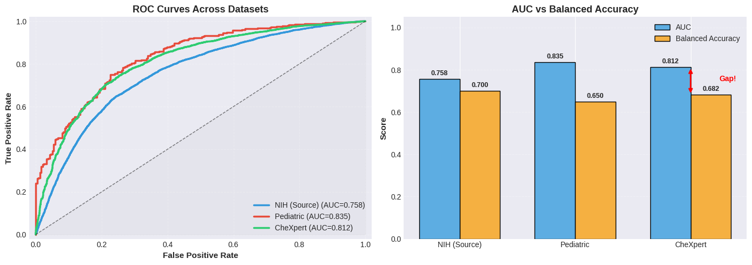
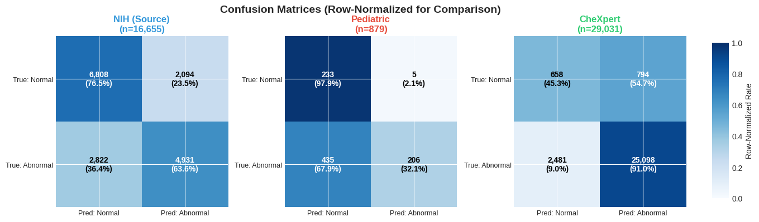
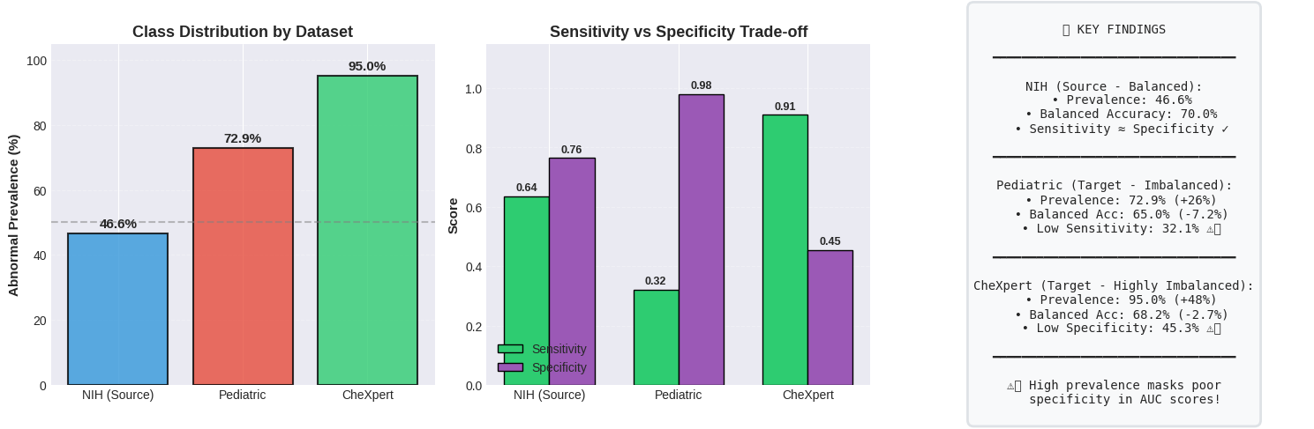

Slide 30
Balanced Accuracy – Fair Evaluation
Balanced Accuracy = average of sensitivity and specificity
Gives equal weight to minority and majority class
Prevents ‘fake’ high scores from trivial majority‑class predictions
Crucial for cross‑dataset comparison with different prevalences
Notes:
Define sensitivity (TPR) and specificity (TNR). Balanced accuracy = (TPR + TNR) / 2.
Use a short example: if a model predicts almost everything as abnormal,
it may have high standard accuracy but low specificity, so balanced accuracy reveals the weakness.

Slide 31
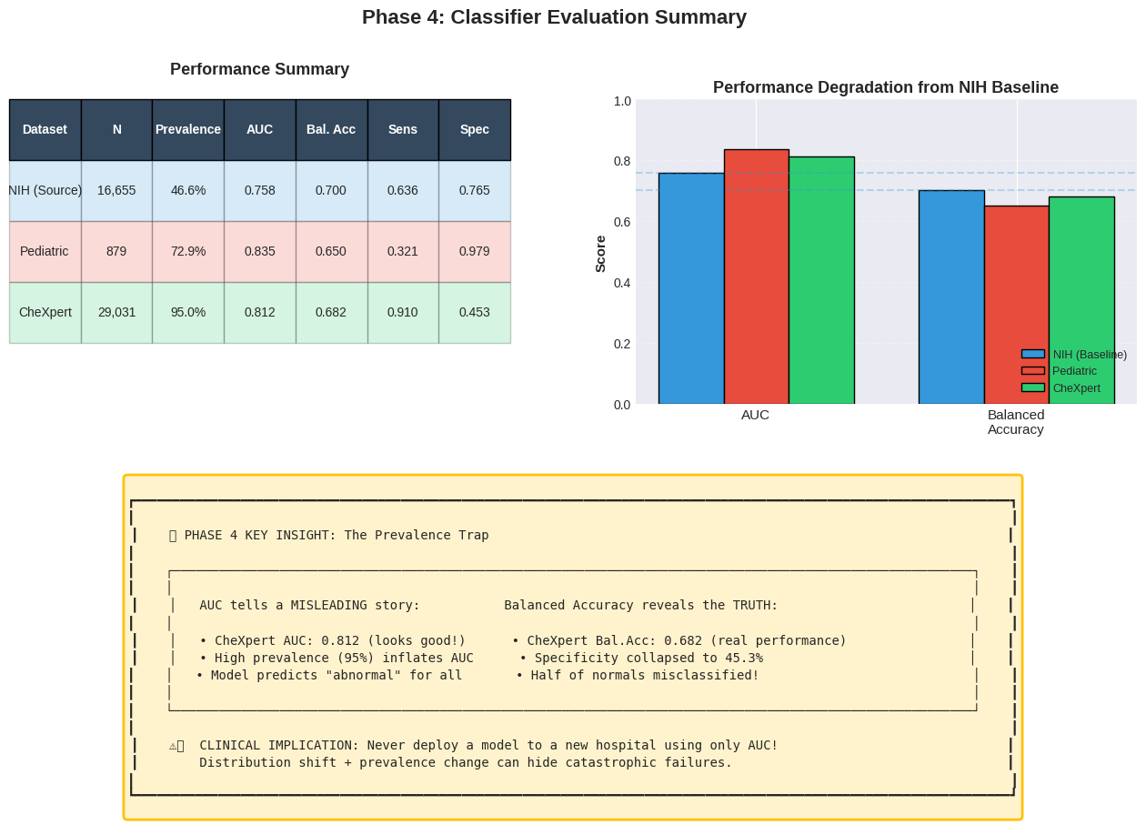
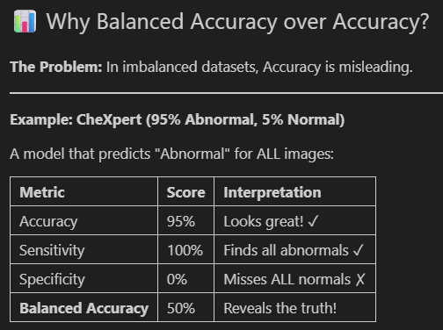
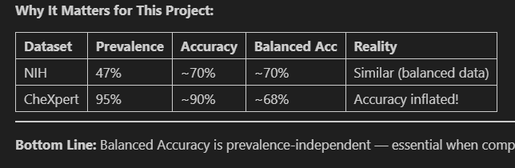

Slide 32
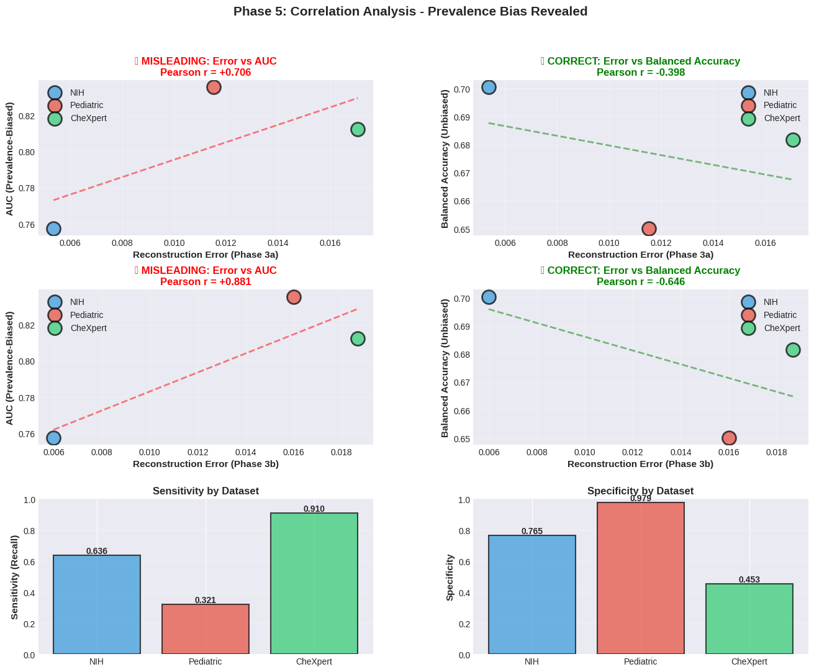
Phase 5 – Correlation Analysis
Notes:
Clarify architecture and training. Stress that the AE and classifier are separate modules.
DenseNet sees raw chest X‑rays; AE is used only for shift analysis, not for classification input.

Slide 33
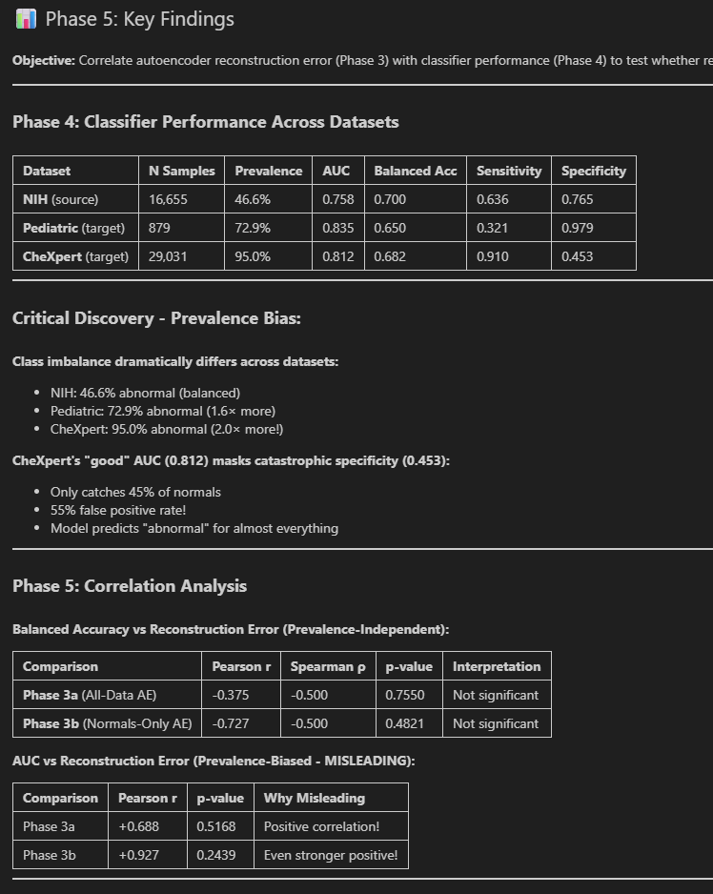
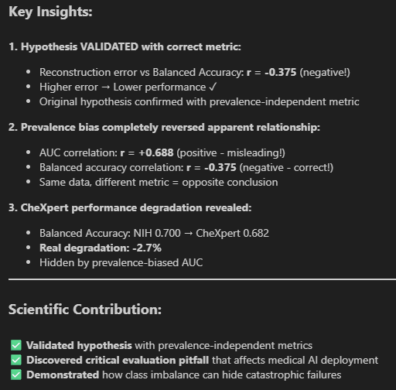
Phase 5 – Correlation Analysis
Notes:
Clarify architecture and training. Stress that the AE and classifier are separate modules.
DenseNet sees raw chest X‑rays; AE is used only for shift analysis, not for classification input.

Slide 34
Limitations, Future Work & Takeaways
Limited to chest X‑rays and three specific datasets
Only one AE architecture and one classifier (DenseNet‑121) explored
Future: correlate AE error with per‑pathology performance drops
Key takeaway: AE reconstruction error is a promising unsupervised domain‑shift signal
Notes:
Briefly acknowledge scope limitations. Then end on the core message: combining an AE ‘shift detector’
with a supervised classifier can make deployments safer and more transparent when data distributions change.

Slide 35
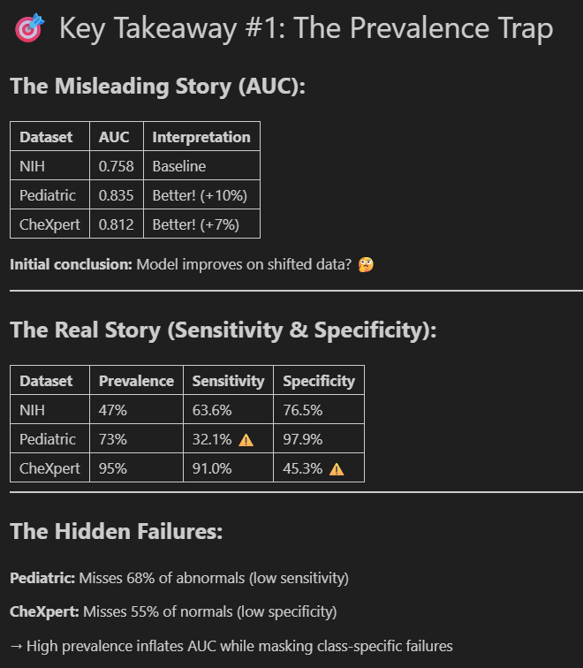
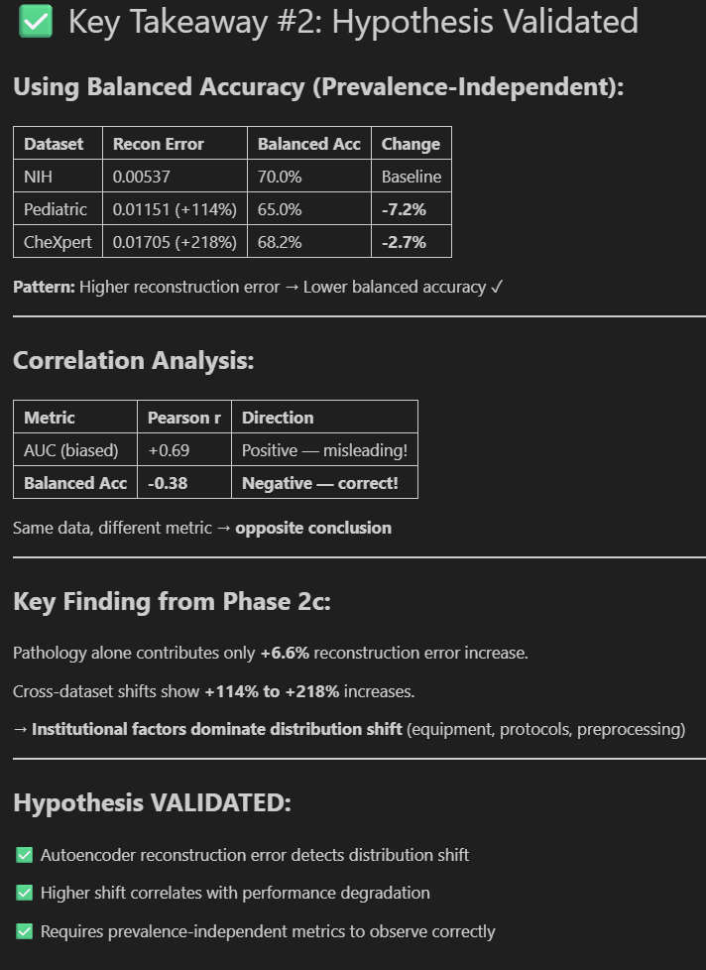
Limitations, Future Work & Takeaways
Notes:
Briefly acknowledge scope limitations. Then end on the core message: combining an AE ‘shift detector’
with a supervised classifier can make deployments safer and more transparent when data distributions change.

Slide 36
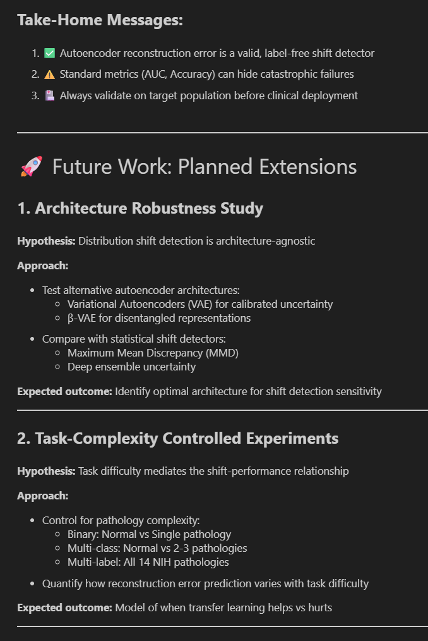
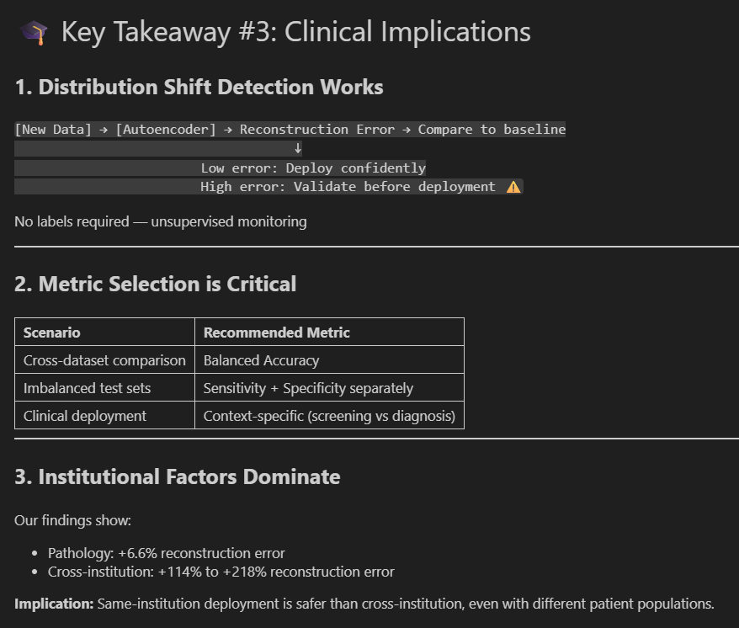
Limitations, Future Work & Takeaways
Notes:
Briefly acknowledge scope limitations. Then end on the core message: combining an AE ‘shift detector’
with a supervised classifier can make deployments safer and more transparent when data distributions change.

Slide 37
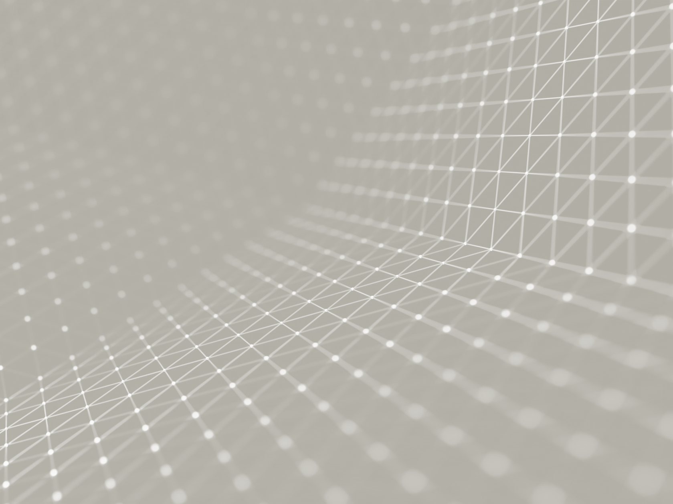
Real‑World Applications
Deploy
Deploy AE as a ‘watchdog’ next to the classifier
Monitor
Monitor reconstruction error on incoming images in real time
Trigger
Trigger alerts or re‑training when error exceeds a threshold
Use
Use shift analysis when evaluating external models for purchase
Notes:
Describe how a hospital could monitor domain shift without waiting for labeled data.
Also mention the procurement scenario: compare how candidate models behave on your local data
and use shift‑sensitivity as one criterion for accepting or rejecting a model.

